Slide 1

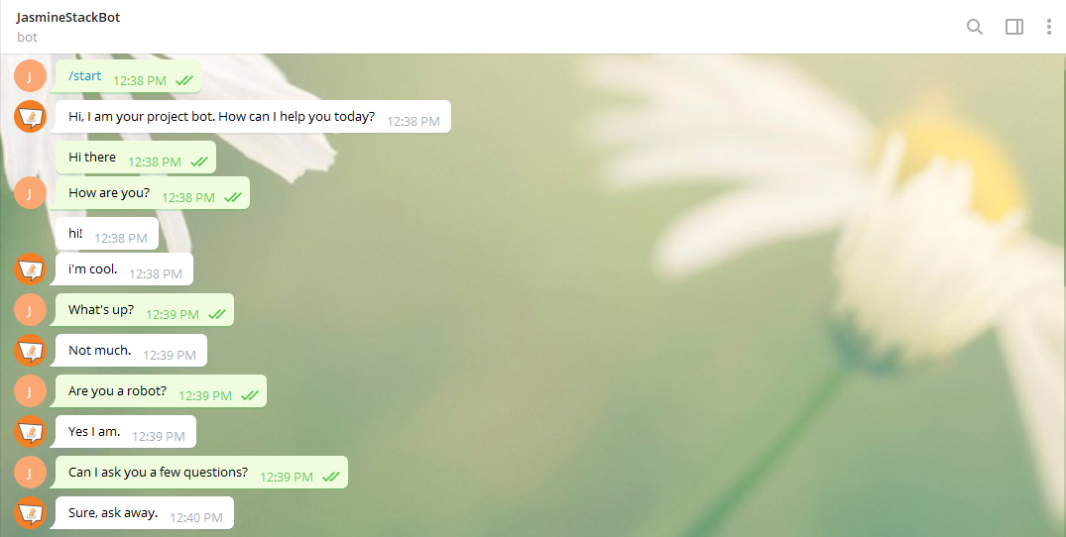
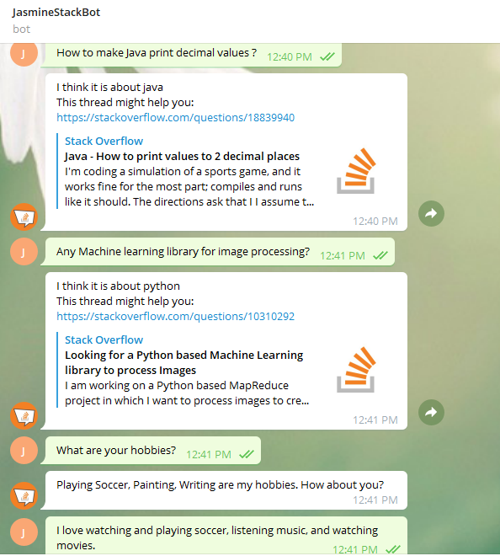
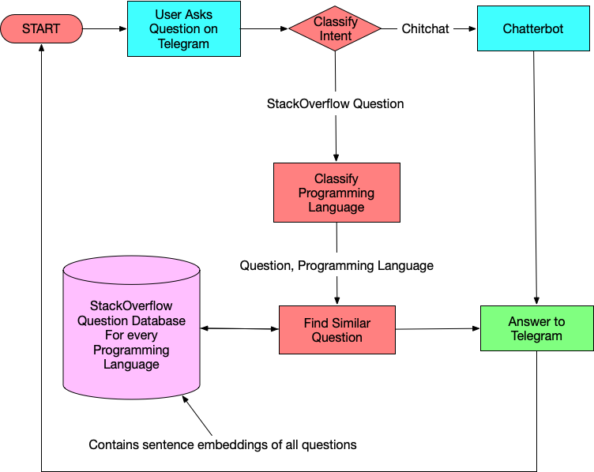
StackOverflow Assistant Chatbot Using NLP
Jasmine Batra | Dr. Sankar Ganesh S | SENSE
Motivation/ Introduction
Results
Stack Overflow is one of the most widely used applications by programming enthusiasts to look up answers for questions that they aren't able to solve, but not everyone finds time to search for a particular question and look into the answers in Stack Overflow through search engines with ease. And even on searching, they get multiple questions/answers to examine to find the best one, making it all the more gruelling. The bot 'JasmineStackBot' is a conversational bot that interacts with the user, and whenever a user asks a programming question, it responds with the stack overflow link to the most similar question.
SCOPE of the Project
Building a conversational chatbot that will assist with search on the Stack Overflow website.
To build a dialogue Chatbot that will be able to:
Answer questions related to programming.
Simulate dialogue and chit-chat on all non-programming related questions.
For programming questions, the Stack Overflow dataset will be used.
For non-programming questions that require a chit-chat mode, a pre-trained neural network engine available from the ChatterBot python library will be used.
Methodology
Figure 1: Flowchart of our StackOverflow Chatbot
Figure 2: Conversation with the bot in Telegram
Building a conversational chatbot that will help with Stack Overflow website search.
After the user asks a question, an Intent-Classifier will predict if the question asked is a Stack Overflow question (programming question) or a dialogue question (non-programming question).
If the question asked is a Stack Overflow question, the bot will respond to the question asked by tagging it with the corresponding programming language using Programming Language (Tag)-Classifier. This classifier will predict which language (tag) a question belongs to if the question is a Stack Overflow question. By doing this, we only search for those language questions in our database. Every question in the dataset is converted to an embedding(vector), and the database contains an embeddings file for every programming language individually. This file contains the vector representation (sentence embeddings) of all questions of that programming language. Ten programming languages are considered here – C/C++, C#, Java, JavaScript, PHP, Python, R, Ruby, Swift, VB. Given that we know the question and the programming language of that question, cosine similarity is used to get the most similar question, and the bot responds with the Stack Overflow Link to that question.
If the question asked is a chit-chat question, the chatterbot will handle it. For a chit-chat mode, we will use a pre-trained neural network engine available from the ChatterBot python library.
Telegram is set up to make our Chatbot communicate with it using the Access token. The bot will be integrated with Telegram messenger so that we can now talk to this bot in Telegram.
Conclusion/ Summary
In this project, I've proposed an approach for designing and building an interactive ChatBot that does question-answering.The proposed approach includes different classifiers, stored question database embeddings, telegram bot handler and their implementations. Experimental results show that the selected algorithms are in accordance with the implementation of the Chatbot approach with good test accuracies. Telegram is used as a frontend medium to ask questions to the bot, which then responds back using the trained models in its back-end. The Chatbot will assist people in searching for solutions to programming questions that they would need and aren’t able to solve (at work or study), and also hold conversations with the user.
Contact Details :
jasmine.batra09@gmail.com
Acknowledgments/ References
N. N. Khin and K. M. Soe, "Question Answering based University Chatbot using Sequence to Sequence Model," 2020 23rd Conference of the Oriental COCOSDA International Committee for the Co-ordination and Standardization of Speech Databases and Assessment Techniques (O-COCOSDA), Yangon, Myanmar, 2020, pp. 55-59.
B. Setiaji and F. W. Wibowo, "Chatbot Using a Knowledge in Database: Human-to-Machine Conversation Modeling," 2016 7th International Conference on Intelligent Systems, Modelling and Simulation (ISMS), Bangkok, 2016, pp. 72-77.

